Slide 1







DBMS
Lab-2

Slide 2
Things we will complete today
Define relations (table)
SQL data types
Integrity constraints
Modifying a relation
Destroying the relation

Slide 3
Define A Table

Slide 4
Let’s Define a table in plain English
Create a table named department. The table should have the following information: department name, name of the building where the department is located, it’s budget and the numbers of stuff the department have.

Slide 5

Let’s Define a table in SQL
Create a table named department. The table should have the following information: department name, name of the building where the department is located, it’s budget and the numbers of stuff the department have.
CREATE TABLE department (
dept_name varchar(100),
building varchar(120),
budget numeric(12,2),
num_staff int
)

Slide 6
SQL DDL
The set of relations in a database must be specified to the system by means of a data-definition language ( DDL ). The SQL DDL allows specification of not only a set of relations, but also information about each relation, including:
• The names of each attribute of the schema.
• The types of values associated with each attribute.
• The integrity constraints.
• The set of indices to be maintained for each relation.
• The security and authorization information for each relation.
• The physical storage structure of each relation on disk

Slide 7
SQL Data types
char(n)
A fixed-length character string with user-specified length n. The full form, character, can also be used instead.
varchar(n)
A variable-length character string with user-specified maximum length n.
int
An integer. The full form, integer, is equivalent.
smallint
A small integer (a machine-dependent subset of the integer type).

Slide 8
SQL Data types
numeric(p,d)
A fixed-point number with user-specified precision. The number consists of p digits (plus a sign), and d of the p digits are to the right of
the decimal point. Thus, numeric(3,1) allows 44.5 to be stored, but neither 444.5 or 0.32 can be stored exactly in a field of this type.
real, double precision
Floating-point and double-precision floating-point numbers with machine-dependent precision.
float(n)
A floating-point number, with precision of at least n digits.

Slide 9
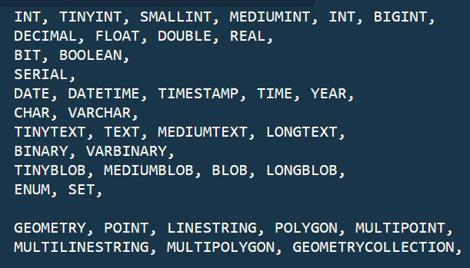
MY SQL Data types
For More About My SQL Datatypes
https://www.tutorialspoint.com/mysql/mysql-data-types.htm

Slide 10
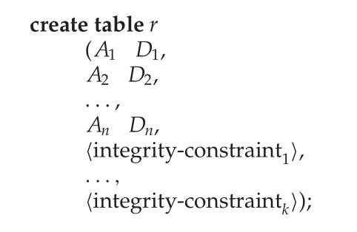
Integrity Constraints in Create Table
not null
primary key (A1, ..., An )
Many more ….
CREATE TABLE department (
dept_name varchar(100),
building varchar(120) not null,
budget numeric(12,2) not null,
num_staff int,
primary key ( )
)
dept_name
primary key declaration on an attribute automatically ensures not null
in SQL-92 onwards, needs to be explicitly stated in SQL-89

Slide 11
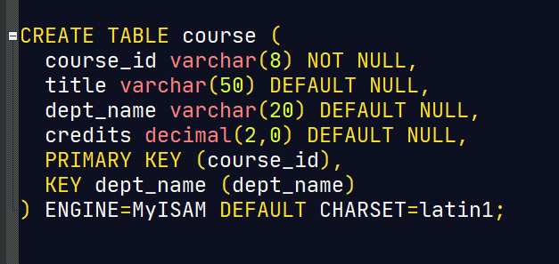
(Almost) Full Definition a table in SQL

Slide 12
Schema modification
Adding/ Removing a column
Modifying column
Deleting the whole scheme

Slide 13
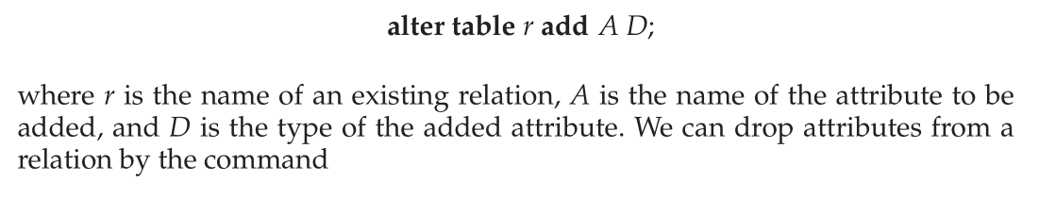
Adding a column
Add a column for department code in department table

Slide 14


Removing a column
Remove the column dept_code from department table

Slide 15
Modifying a column
change column length of dept_code

Slide 16



Deleting the WHOLE table
Deleting only data (Keep table structure)
Two option
or

Slide 17
Demo.

Slide 18
End.

